Slide 1
Geospatial Indexing & Search
at Scale with Lucene
Nick Knize, PhD
Lucene PMC Member + Committer
@nknize
Notes:
‹#›

Slide 2

Lets take a trip...
...through Geo advancements
1
Lucene Geo in Elasticsearch & OpenSearch - an Introduction
2
Lucene Geo Search, Then & Now: Prefix Trees vs. BKD Trees
3
Improving Shape Search: BKD + Tessellation
2
4
Geo Analytics: Doc Values and Aggregations / Facets

Slide 3
Mappings
Geo Field Types

Slide 4
geo_point mapping
define
PUT crime/incidents/_mapping
{
“properties” : {
“location” : {
“type” : “geo_point”,
“ignore_malformed” : true,
}
}
}

Slide 5
geo_point mapping
insert
POST crime/incidents
{
“location” : { “lat” : 41.12, “lon” : -71.34 }
}
POST crime/incidents
{
“location” : “41.12, -71.34”
}
POST crime/incidents
{
“location” : [[-71.34, 41.12], [-71.32, 41.21]]
}

Slide 6
geo_shape mapping
define
PUT police/precincts/_mapping
{
“properties” : {
“coverage” : {
“type” : “geo_shape”,
“ignore_malformed” : false,
“tree” : ”quadtree”,
“precision” : “5m”,
“distance_error_pct“ : 0.025,
“orientation” : “ccw”,
“points_only” : false
}
}
}

Slide 7
geo_shape mapping
insert
POST police/precincts/
{
“coverage” : {
“type” : “polygon”,
“coordinates” : [[
[-73.9762134, 40.7538588],
[-73.9742356, 40.7526327],
[-73.9656733, 40.7516774],
[-73.9763236, 40.7521246],
[-73.9723788, 40.7516733],
[-73.9732423, 40.7523556],
[-73.9762134, 40.7538588]
]]
}
}

Slide 8
geo_shape mapping
insert
Shapes are parsed using OGC and ISO standards definitions
OGC Simple Feature Access
ISO Geographic information — Spatial Schema (19107:2003)
Supports the following geo_shape types
Point, MultiPoint
LineString, MultiLineString
Polygon (with holes), MultiPolygon (with holes)
Envelope (bbox)

Slide 9
Indexing
Under the hood

Slide 10
A long, long time ago, in a galaxy far far away...
...the Inverted [text] Index
terms dictionary (terms) | postings list (doc ids)
Quick | 2
Springtails | 2
The | 1
boxing | 1
cool | 2
jumping | 2
jumps | 1
on | 2
quickly | 1
water | 2
wizard | 1
1
The boxing wizard jumps quickly
2
Quick jumping Springtails on cool water

Slide 11

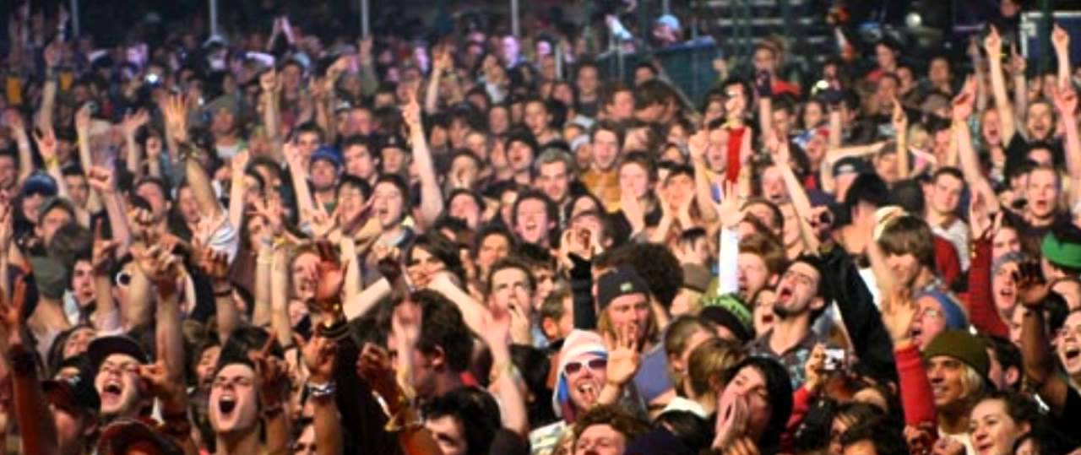
And the open source community went bananas!
we Lucene TEXT search!

Slide 12
But what about 1D numbers...?
Prefix Trees; precision
terms dictionary (terms) | postings list (doc ids)
1 | 1, 2, 3, 4, 5
10 | 2, 3, 4
11 | 1, 5
100 | 2
101 | 3, 4
111 | 1, 5
1000 | 2
1010 | 4
1011 | 3
1110 | 1
1111 | 5
1 myINT: 3881553173
1110 0111 0101 1011 1100 1101 0001 0101
2 myINT: 2405166357
1000 1111 0101 1011 1110 1101 0001 0101
3 myINT: 3205335297
1011 1111 0000 1101 1000 1001 0000 0001
4 myINT: 2835679237
1010 1001 0000 0101 0000 1000 0000 0101
5 myINT: 4177856517
1111 1001 0000 1101 0000 1000 0000 0101

Slide 13
But what about 1D numbers...?
Prefix Trees; precision
terms dictionary (terms) | postings list (doc ids)
1 | 1, 2, 3, 4, 5
10 | 2, 3, 4
11 | 1, 5
100 | 2
101 | 3, 4
111 | 1, 5
1000 | 2
1010 | 4
1011 | 3
1110 | 1
1111 | 5
1 myINT: 3881553173
1110 0111 0101 1011 1100 1101 0001 0101
2 myINT: 2405166357
1000 1111 0101 1011 1110 1101 0001 0101
3 myINT: 3205335297
1011 1111 0000 1101 1000 1001 0000 0001
4 myINT: 2835679237
1010 1001 0000 0101 0000 1000 0000 0101
5 myINT: 4177856517
1111 1001 0000 1101 0000 1000 0000 0101

Slide 14
And the Lucene community went bananas...again...
we Lucene NUMERIC search!

Slide 15

But, but, what about Geo?
…we’re cool too!

Slide 16
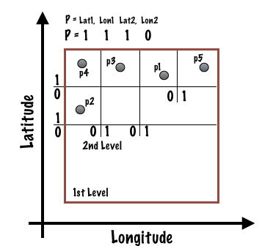
How about Geo...terms?
Prefix Trees; round peg, square hole
terms dictionary (terms) | postings list (doc ids)
1 | 1, 2, 3, 4, 5
10 | 2, 3, 4
11 | 1, 5
100 | 2
101 | 3, 4
111 | 1, 5
1000 | 2
1010 | 4
1011 | 3
1110 | 1
1111 | 5

Slide 17
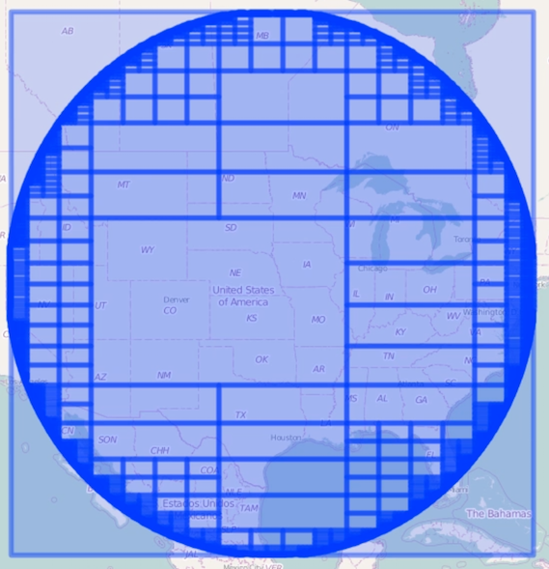
Searching for round pegs in square holes...
Traversing the Prefix Tree...
terms dictionary (terms) | postings list (doc ids)
1 | 1, 2, 3, 4, 5
10 | 2, 3, 4
11 | 1, 5
100 | 2
101 | 3, 4
111 | 1, 5
1000 | 2
1010 | 4
1011 | 3
1110 | 1
1111 | 5
4
3
1
5
2

Slide 18
Searching for round pegs in square holes...
Traversing the Prefix Tree...
terms dictionary (terms) | postings list (doc ids)
1 | 1, 2, 3, 4, 5
10 | 2, 3, 4
11 | 1, 5
100 | 2
101 | 3, 4
111 | 1, 5
1000 | 2
1010 | 4
1011 | 3
1110 | 1
1111 | 5
4
3
1
5
2

Slide 19
Searching for round pegs in square holes...
Traversing the Prefix Tree...
terms dictionary (terms) | postings list (doc ids)
1 | 1, 2, 3, 4, 5
10 | 2, 3, 4
11 | 1, 5
100 | 2
101 | 3, 4
111 | 1, 5
1000 | 2
1010 | 4
1011 | 3
1110 | 1
1111 | 5
4
3
1
5
2

Slide 20
Searching for round pegs in square holes...
Traversing the Prefix Tree...
terms dictionary (terms) | postings list (doc ids)
1 | 1, 2, 3, 4, 5
10 | 2, 3, 4
11 | 1, 5
100 | 2
101 | 3, 4
111 | 1, 5
1000 | 2
1010 | 4
1011 | 3
1110 | 1
1111 | 5
4
3
1
5
2

Slide 21
Searching for round pegs in square holes...
Traversing the Prefix Tree...
terms dictionary (terms) | postings list (doc ids)
1 | 1, 2, 3, 4, 5
10 | 2, 3, 4
11 | 1, 5
100 | 2
101 | 3, 4
111 | 1, 5
1000 | 2
1010 | 4
1011 | 3
1110 | 1
1111 | 5
4
3
1
5
2

Slide 22
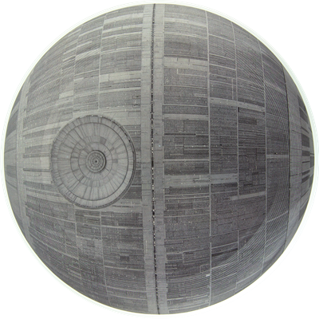
Searching for round pegs in square holes...
Traversing the Prefix Tree...of death?
terms dictionary (terms) | postings list (doc ids)
1 | 1, 2, 3, 4, 5
10 | 2, 3, 4
11 | 1, 5
100 | 2
101 | 3, 4
111 | 1, 5
1000 | 2
1010 | 4
1011 | 3
1110 | 1
1111 | 5

Slide 23

Okay, cool! But what about GeoShapes?!
Quad Trees!

Slide 24
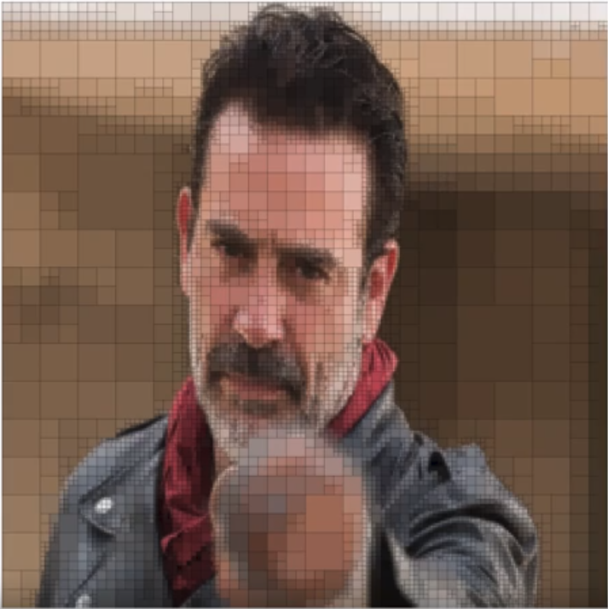
Okay, cool! But what about GeoShapes?!
Use the Inverted [geo] Index...
terms dictionary (terms) | postings list (doc ids)
1 | 1, 2, 3, 4, 5
10 | 1, 2, 4
11 | 3, 5
100 | 1
101 | 2, 4
111 | 3, 5
1000 | 2
1010 | 4
1011 | 3
1110 | 3
1111 | 5
DocID: 6

Slide 25

Okay, cool! But what about GeoShapes?!
Use the Inverted [geo] Index...
terms dictionary (terms) | postings list (doc ids)
1 | 1, 2, 3, 4, 5, 6
10 | 1, 2, 4
11 | 3, 5, 6
100 | 1
101 | 2, 4
111 | 3, 5, 6
1000 | 2
1010 | 4
1011 | 3
1110 | 3, 6
1111 | 5, 6
DocID: 6

Slide 26

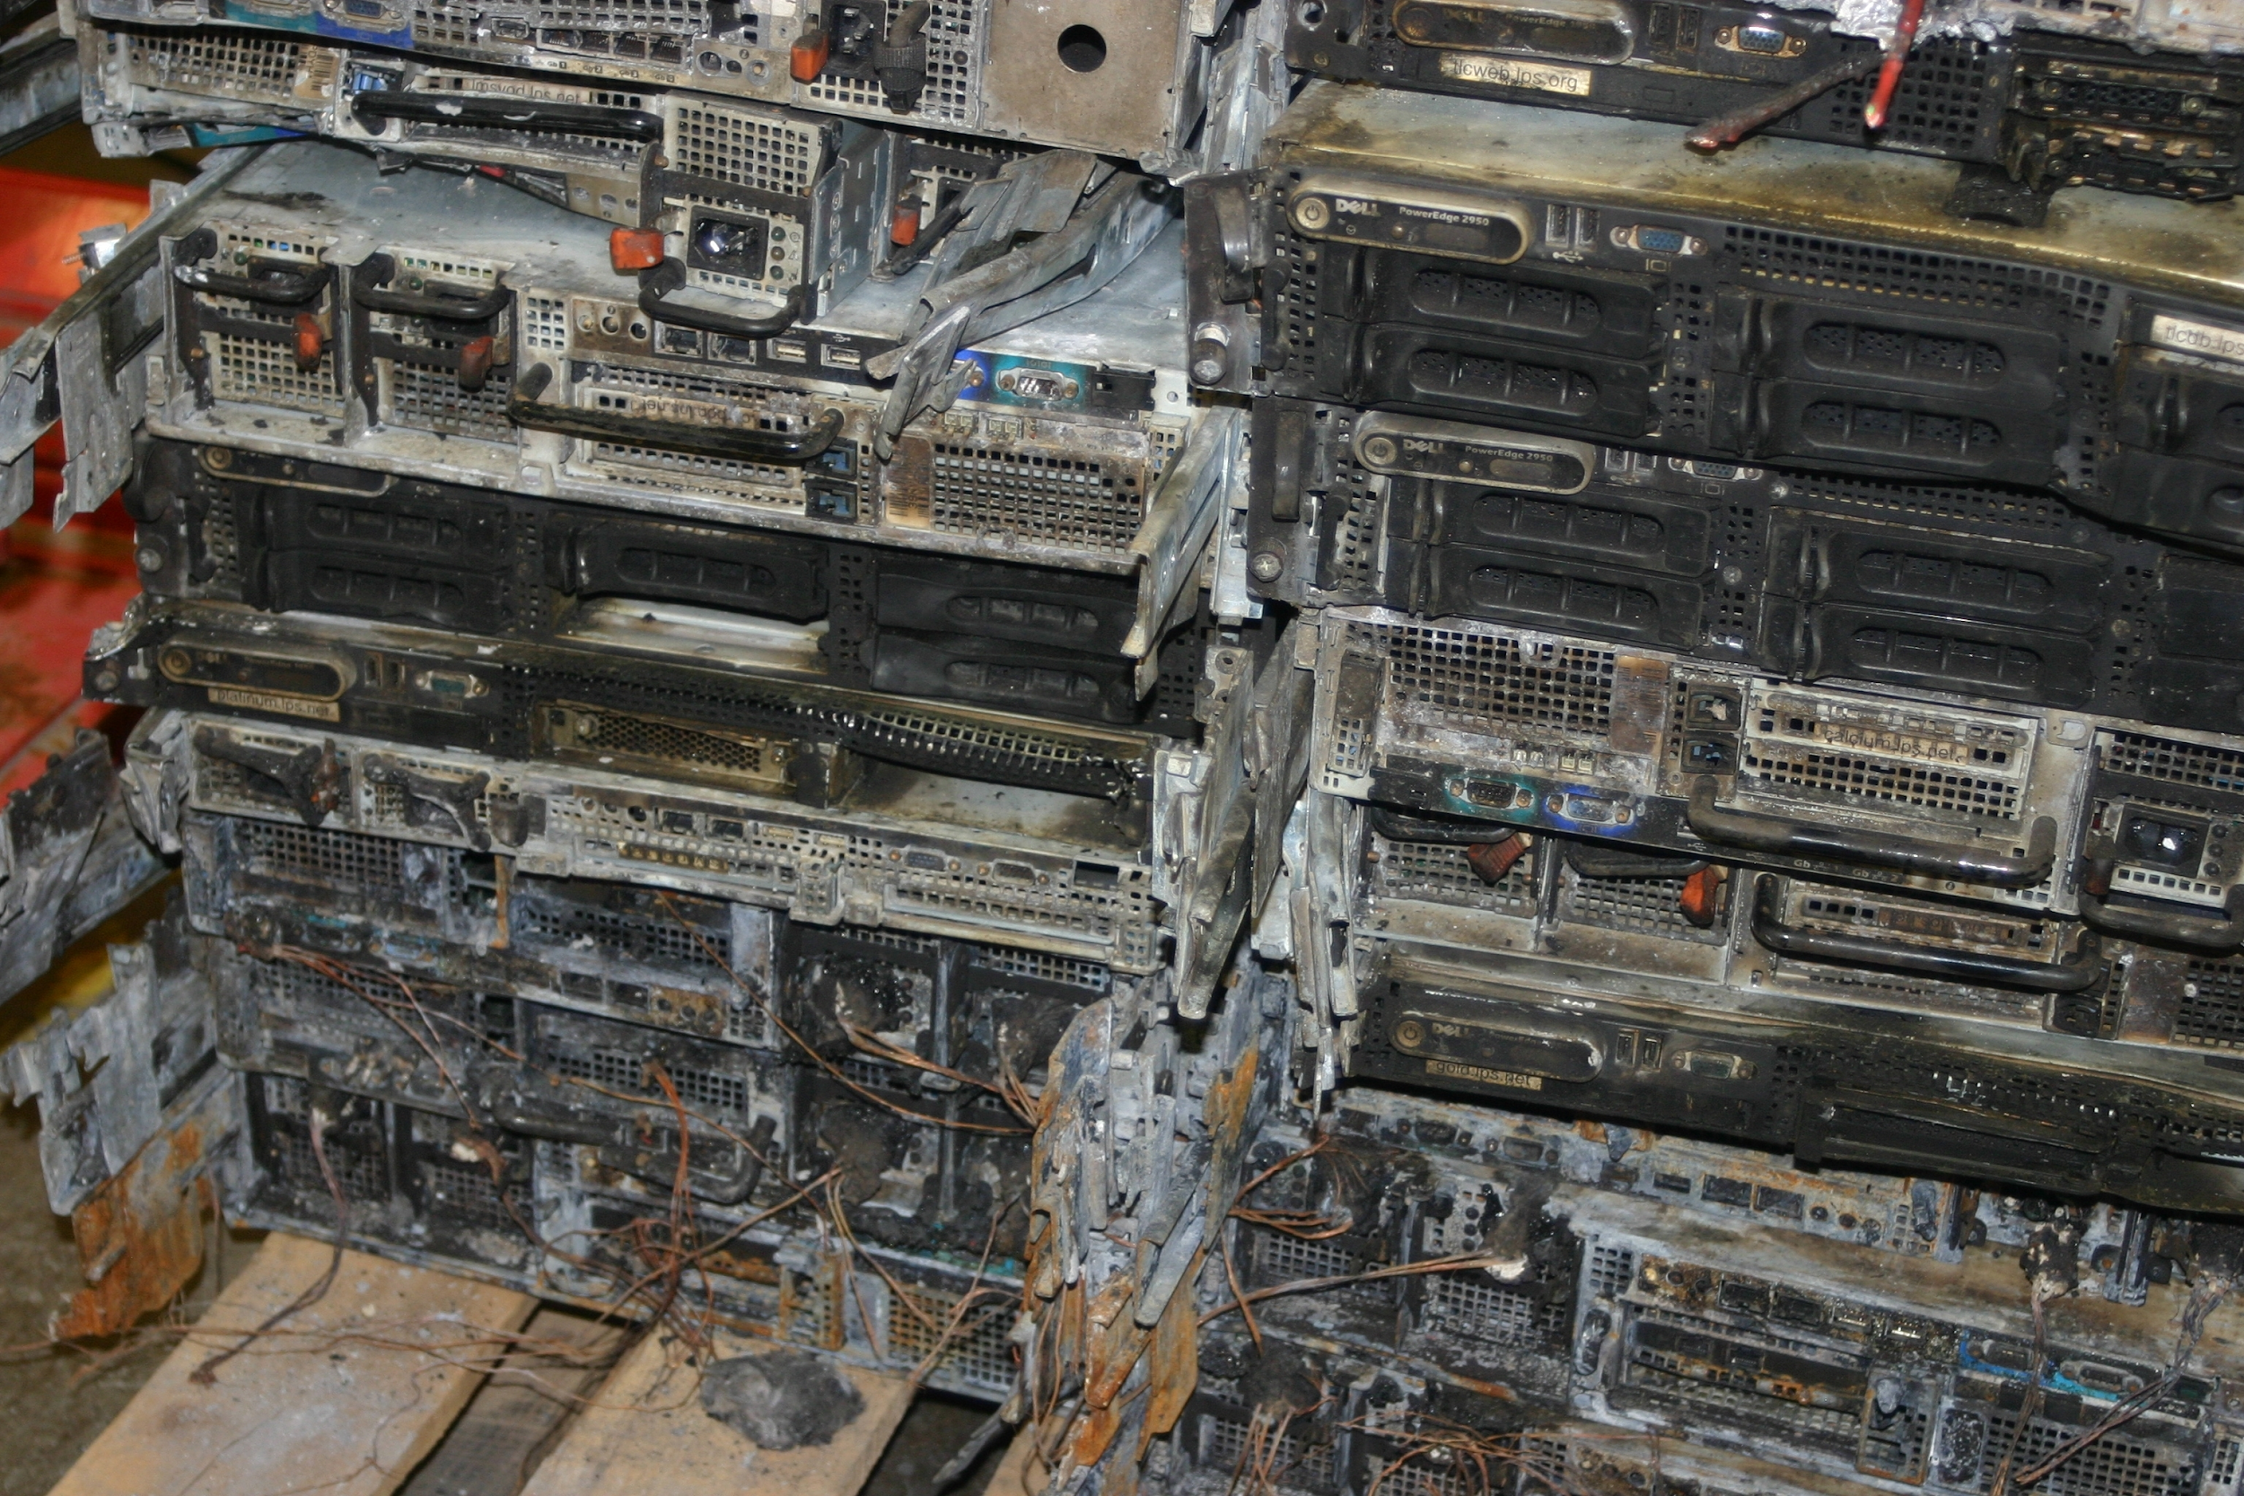
Okay, cool! But what about GeoShapes?!
Melt with the Inverted [geo] Index...

Slide 27
Okay, cool! But what about GeoShapes?!
Melt with the Inverted [geo] Index...
Max tree_levels == 32 (2 bits / cell)
distance_error_pct
“slop” factor to manage transient memory usage
% of the diagonal distance (degrees) of the shape
Default == 0 if precision set (2.0)
points_only
optimization for points only shape index
short-circuits recursion

Slide 28
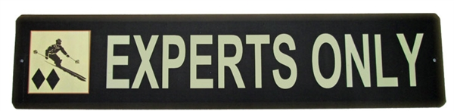
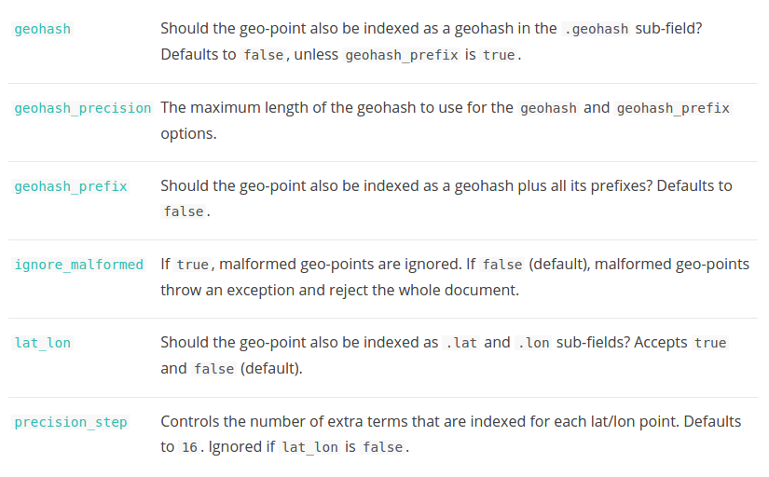
geo search?
pssh… it’s simple!
WTF?!
¯\_(ツ)_/¯
¯\_(ツ)_/¯
¯\_(ツ)_/¯
¯\_(ツ)_/¯
¯\_(ツ)_/¯
¯\_(ツ)_/¯
¯\_(ツ)_/¯
¯\_(ツ)_/¯
¯\_(ツ)_/¯
¯\_(ツ)_/¯
¯\_(ツ)_/¯
¯\_(ツ)_/¯

Slide 29


Slide 30
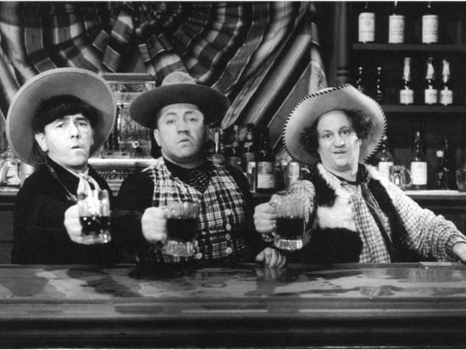
For duty and humanity!

Slide 31
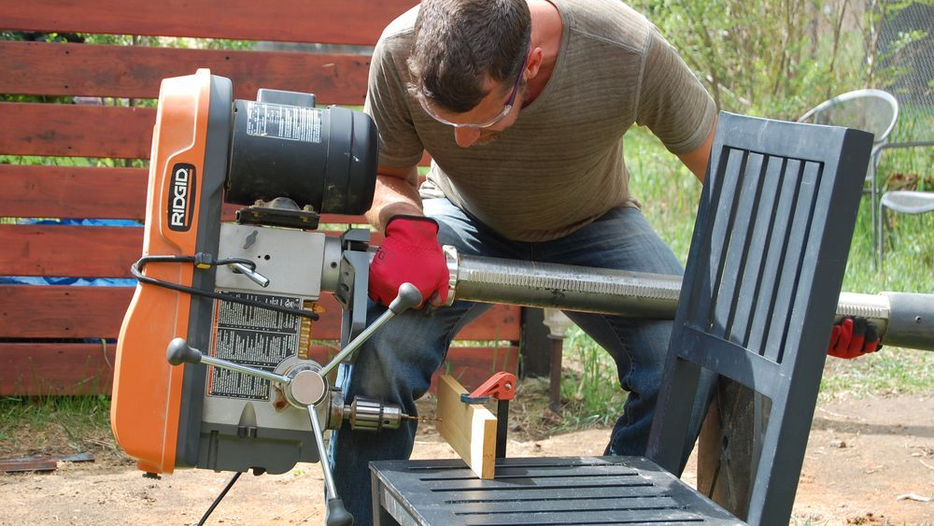
We’re doing it wrong

Slide 32

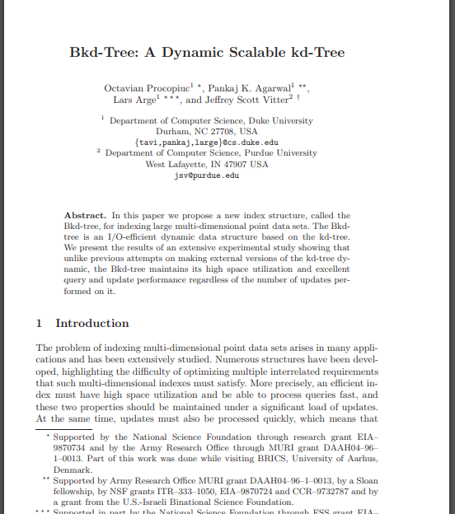

Slide 33
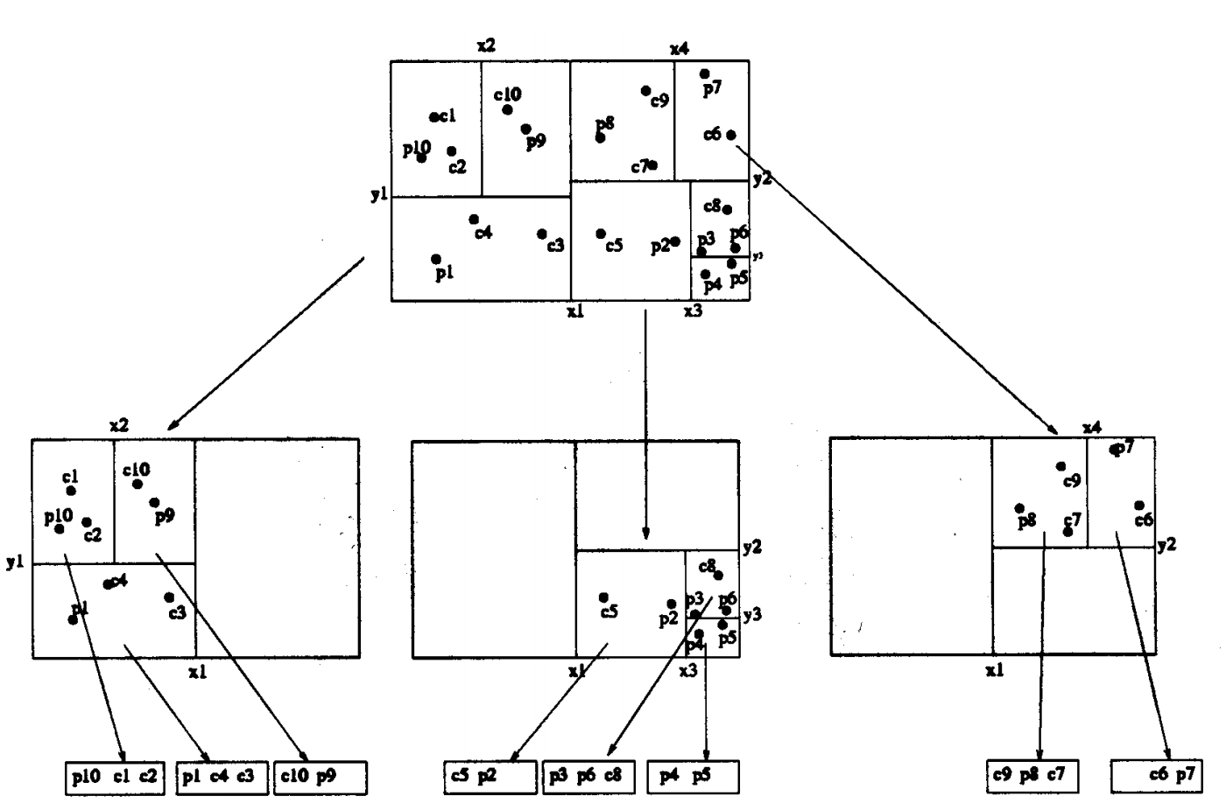
Block K Dimensional Trees (Bkd) to the rescue!
...the right tool!

Slide 34
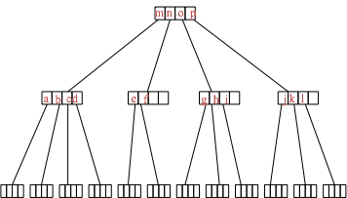
Block K Dimensional Trees (Bkd) to the rescue!
...the right tool!
Min_{y} Min_{x} Max_{y} Max_{x}
m: root node

Slide 35
Block K Dimensional Trees (Bkd) to the rescue!
...the right tool!
Min_{y} Min_{x} Max_{y} Max_{x}
m: internal node

Slide 36
Block K Dimensional Trees (Bkd) to the rescue!
...the right tool!
Y_{val} X_{val}
leaf node

Slide 37
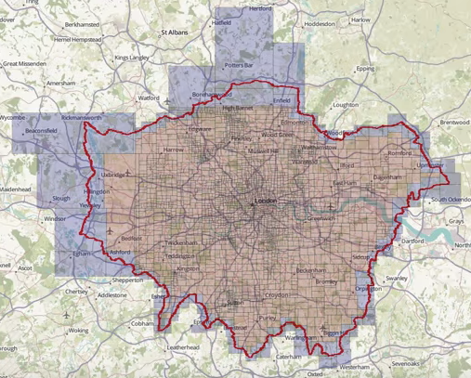
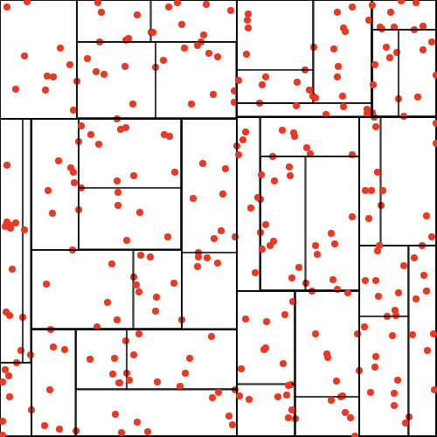
Block K Dimensional Trees (Bkd) to the rescue!
...the right tool!

Slide 38
Block K Dimensional Trees (Bkd) to the rescue!
...not exactly multi-way - today…

Slide 39
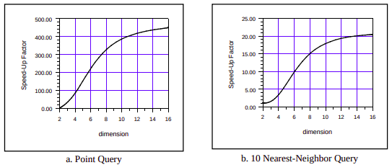
Block K Dimensional Trees (Bkd) to the rescue!
Beyond Geo… multi-way tree improvements
Improve Bkd for high dimension Vector Data…. (e.g., LiDAR, Spectral)

Slide 40
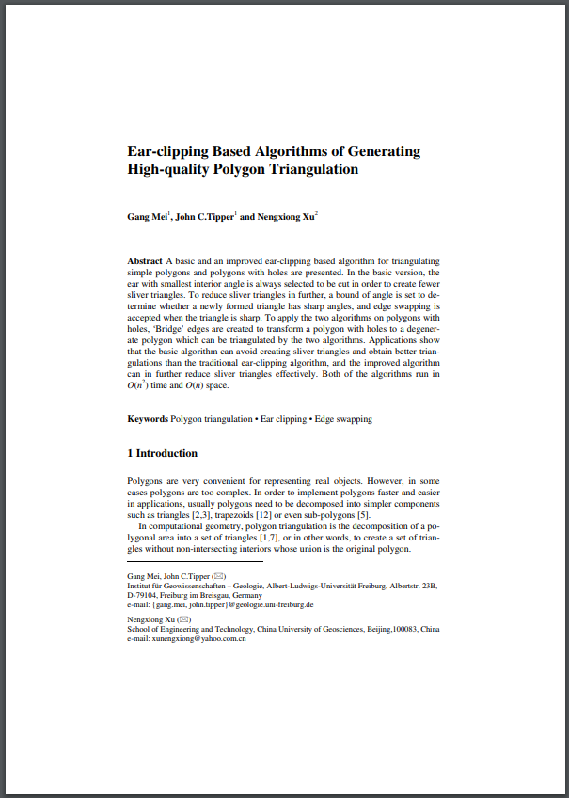

Okay, cool! But what about GeoShapes?!
Tessellation!

Slide 41
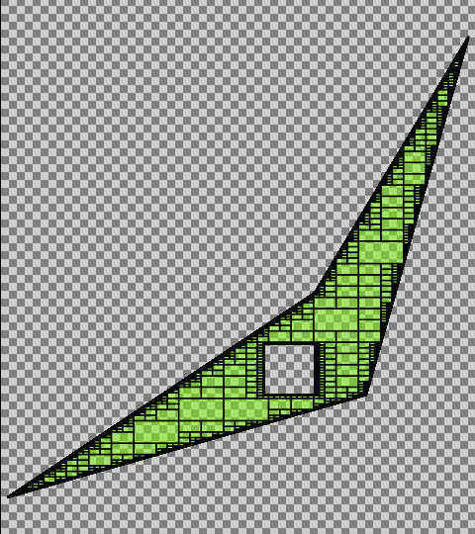
Quad Tree Decomposition
Simple polygon example
8 vertex polygon
1º x 1º coverage area
3m quad cell resolution
1,105,889 terms

Slide 42
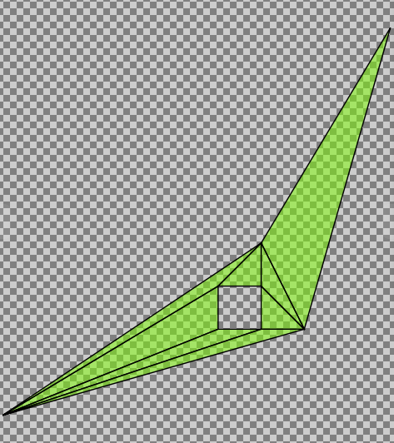
Tessellation Decomposition
Simple polygon example
8 vertex polygon
1º x 1º coverage area
3m quad cell resolution
1,105,889 terms
1.11 cm resolution
8 terms
138,236 : 1 term ratio
\ (•◡•) / smaller, faster index!

Slide 43

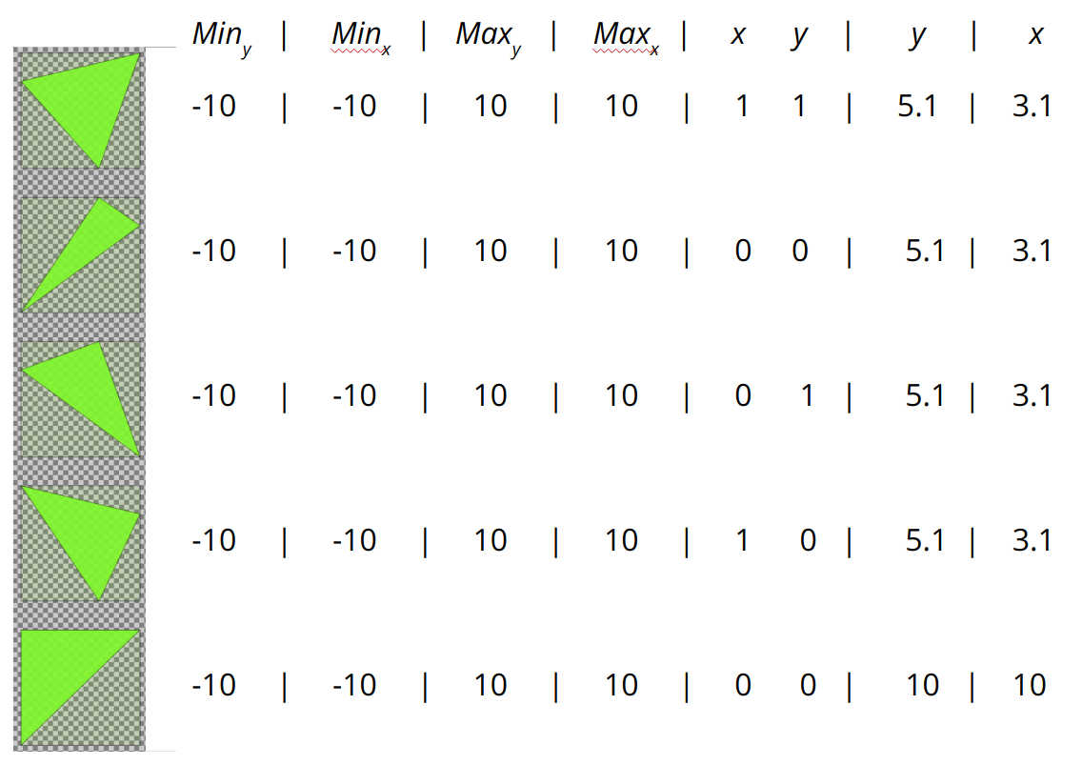
Tessellation + BKD
a made in… Lucene 7.4
Min_{y} Min_{x} Max_{y} Max_{x}
m: internal node
???
leaf node

Slide 44
Tessellation + BKD
a seven dimension made in… Lucene 7.4
1 0
0 1
Index Dimensions
Data Dimensions

Slide 45
Tessellation + BKD
a made in… Lucene 7.4
Min_{y} Min_{x} Max_{y} Max_{x}
m: internal node
???
leaf node

Slide 46
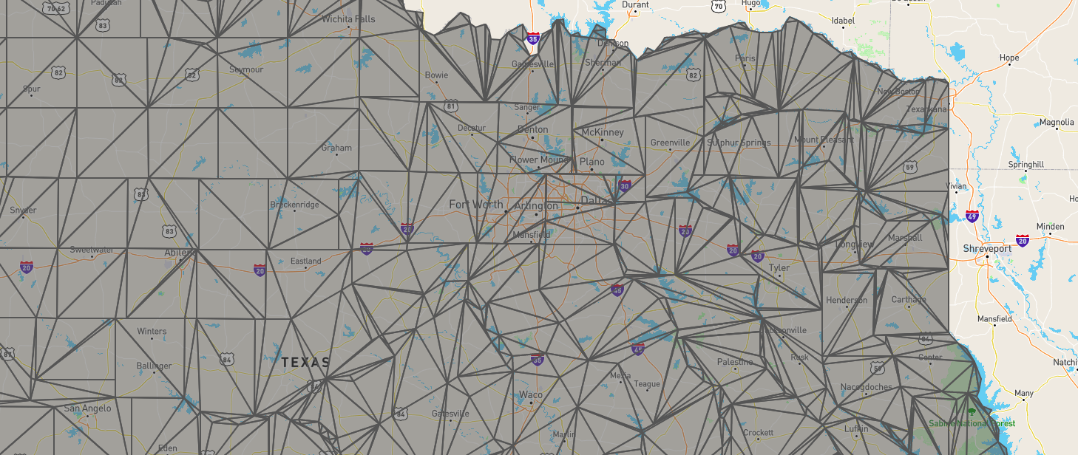
Smaller, faster, stronger...
Searching triangle intersections

Slide 47
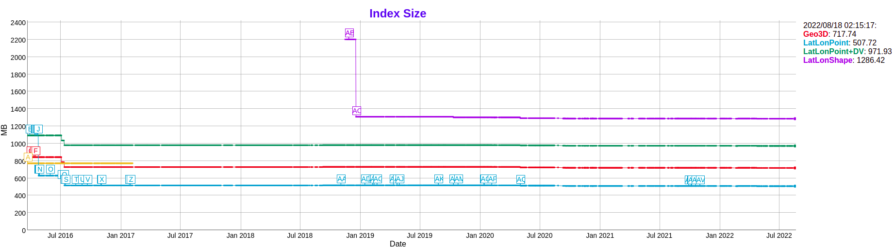
Smaller, faster, stronger… at scale
Smaller index...

Slide 48
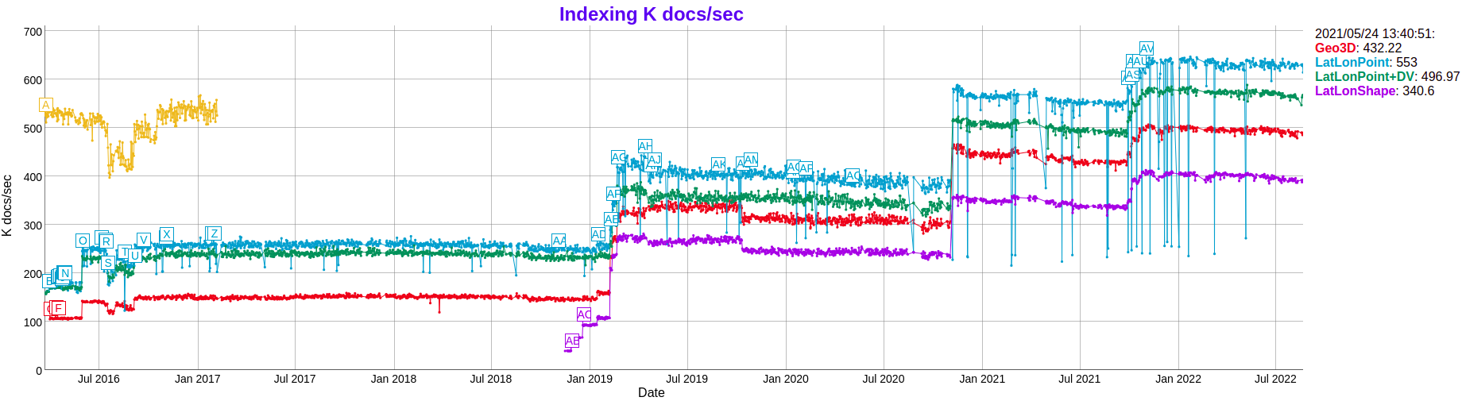
Smaller, faster, stronger… at scale
Faster indexing - Nearly as fast as points!!

Slide 49

Smaller, faster, stronger… at scale
Happy users…
"...test that was crashing a shard on a node with 16GB heap after running for 4.5 hours now finishes in less than 1sec"
@esri: "results show that the insert operation is 25 to 30 times faster...along with better performance we also get accurate results for spatial queries"

Slide 50
geo search?
pssh… it’s simple!
WTF?!
¯\_(ツ)_/¯
¯\_(ツ)_/¯
¯\_(ツ)_/¯
¯\_(ツ)_/¯
¯\_(ツ)_/¯
¯\_(ツ)_/¯

Slide 51
So, what’s next??
Use case application goodies...
Non-geo use cases (`XYShape` type)
CAD Drawings (Design, County / City Planning)
Venue Mapping (Universal Studios, Disney, Hotels, Schools)
Sports analysis (Chicago Cubs, Baseball Advanced Media)
Virtual Gaming & Mapping (Blizzard, Cyber Security / SIEM)
Other coordinate systems (datum / projection support)
Non terrestrial planet models
Localized projections
Custom projections
Beyond 2D - Multi-Way Tree
Space - Time (OGC Moving Features)
Elevation Modelling (DEM, DTM)
LiDAR (3D Modelling)
Released in 8.2
Released in 8.5
In Work

Slide 52
Geo Analytics
Aggregations (Elasticsearch / OpenSearch)
Facets (Solr)

Slide 53
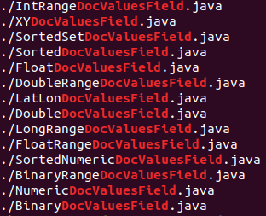
Analytics use Doc Values…
As of Lucene 9.3: numeric, numeric sorted, binary, binary sorted…

Slide 54
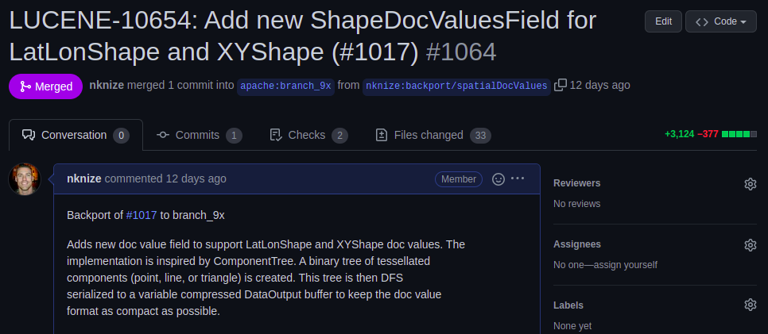
Shape Doc Values Columnar Field…
shape → serialized binary doc value field
LUCENE 9.4

Slide 55
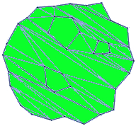
Shape Doc Values Columnar Field…
shape → serialized binary doc value field
…
DFS Serialize (variable buffer)
Version
BBox
Centroid
Header
Triangle(s)
ByteSize
BBox
Header
Triangle(s)
ByteSize
BBox
Header
Triangle(s)
…
root
left subtree level 1
left subtree level 2

Slide 56
{
"aggs" : {
“sf_rings" : {
"geo_distance" : {
"field" : "location",
"origin" : [32.95,
-96.82],
"ranges" : [
{ "to" : 50 },
{ "from" : 50,
"to" : 100 },
{ "from" : 100,
"to" : 300}
]
}
}
}
}
GeoDistance

Slide 57
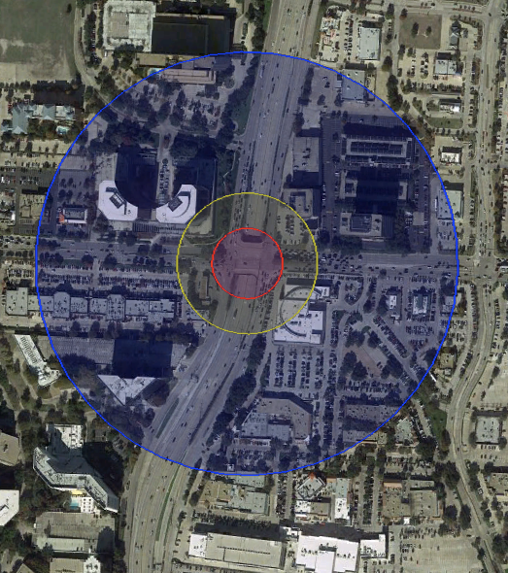
GeoDistance

Slide 58
{
"aggs" : {
“crime_cells" : {
"geohash_grid" : {
"field" : "location",
"precision" : 8
}
}
}
}
GeoGrid

Slide 59
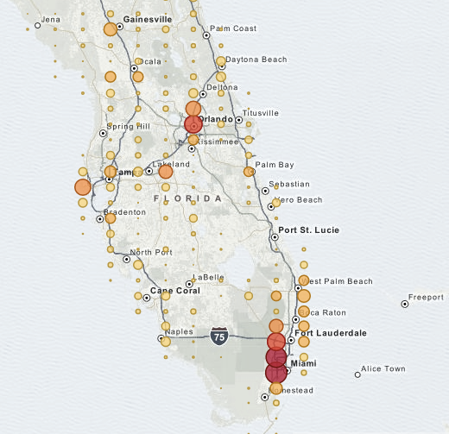
GeoGrid

Slide 60
{
"aggs": {
"zoomGrid": {
"geotile_grid": {
"field": “location”,
“precision”: 12
}
}
}
}
GeoTile Grid

Slide 61
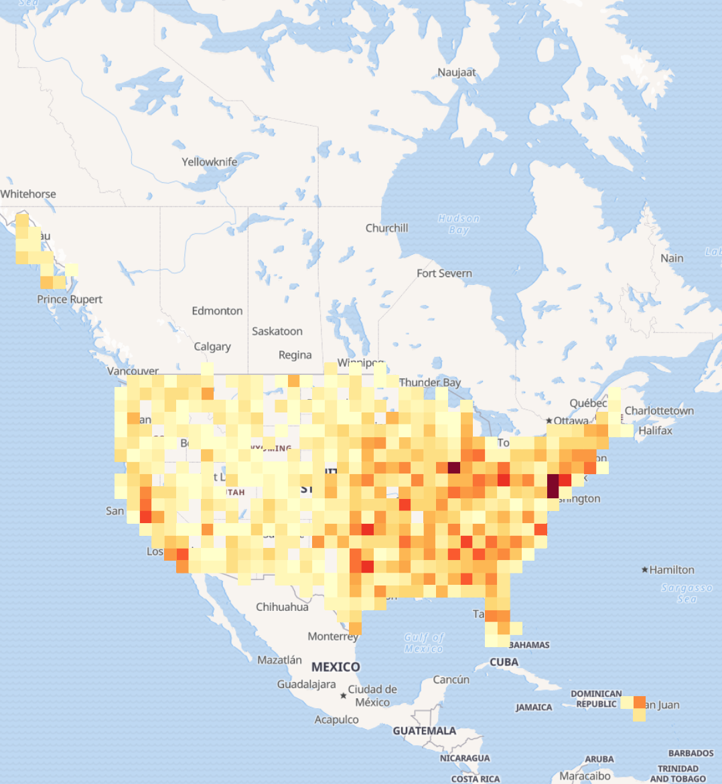
GeoTile Grid

Slide 62
"query" : {
"match" : {
"crime" : "burglary"
}
},
"aggs" : {
"towns" : {
"terms" : { "field" : "town" },
"aggs" : {
"centroid" : {
"geo_centroid" : {
"field" : “location"
}
}
}
}
}
GeoCentroid

Slide 63
GeoCentroid

Slide 64
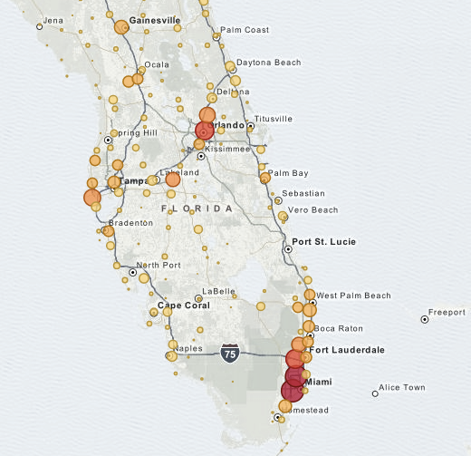
GeoCentroid

Slide 65
{
"aggs": {
"statistics": {
"matrix_stats": {
"fields": ["poverty", "income"]
}
}
}
}
matrix_stats
Agg

Slide 66
"aggregations": {
"statistics": {
"doc_count": 50,
"fields": [{
"name": "income",
"count": 50,
"mean": 51985.1,
"variance": 7.383377037755103E7,
"skewness": 0.5595114003506483,
"kurtosis": 2.5692365287787124,
"covariance": {
"income": 7.383377037755103E7,
"poverty": -21093.65836734694
},
"correlation": {
"income": 1.0,
"poverty": -0.8352655256272504
}
}, {
"name": "poverty",
"count": 50,
"mean": 12.732000000000001,
"variance": 8.637730612244896,
"skewness": 0.4516049811903419,
"kurtosis": 2.8615929677997767,
"covariance": {
"income": -21093.65836734694,
"poverty": 8.637730612244896
},
"correlation": {
"income": -0.8352655256272504,
"poverty": 1.0
}
}]
}
matrix_stats
Agg

Slide 67

Spatial Aggregations
more available, and coming soon...
pca - ML foundation plugin
dimensionality reduction
image analysis
classification / recognition
geo_stats - In work...
Moran’s I - measuring spatial auto-correlation
Getis-Ord - spatial hot spot analysis

Slide 68


THANK YOU
Follow for updates:
@nknize
apache/lucene
Notes:
‹#›

